Slide 1
Controlled Greenhouse
Ghanim Al-Ghanim 437104932
Othman Al-Beyabi 437100900
Supervisor: Dr. Abdulwadood Abdulwaheed

Slide 2
1.Introduction
1.1 Problem statement
This project aims to combat several challenges at once in that it will make farming and agriculture much more accessible to all people, the public would start making mini-farms inside houses and farmers lives will be made much easier with them gaining the ability to possibly remotely monitor and issue general commands regarding their farms.

Slide 3
1.Introduction
1.2 Objective
To help in increasing water usage proficiency, and water level being utilized in a rational manner.
Development of the crops depends on proper scheduling of irrigation and irrigation techniques.
Humidity, temperature, and wind speed are some of the factors that need to be monitored.

Slide 4
1.Introduction
1.3 Related work
The OpenAG™ personal food computer (PFC), is an open-source platform that is personal use which reduces the size, number of a system component, and it is a customizable platform.

Slide 5
1.Introduction
1.3 Related work (cont.)
The FarmBot is an Open-Source Computer numerical control Farming Company that have provide a farming robot and provide all their research in the open-source website.

Slide 6
2.Greenhouse Design
2.1 Introduction
In this section we are going through the three different designs. We will go through each one in details. Initially, we got inspired from MIT’s Open Agriculture Initiative: Personal Food Computer Then we designed a 3D greenhouse to agree on the structure and have an idea about the shape and the layout of the plants and other parts in the greenhouse. We have used the first two designs to satisfy the needs of an effective automated greenhouse system.

Slide 7
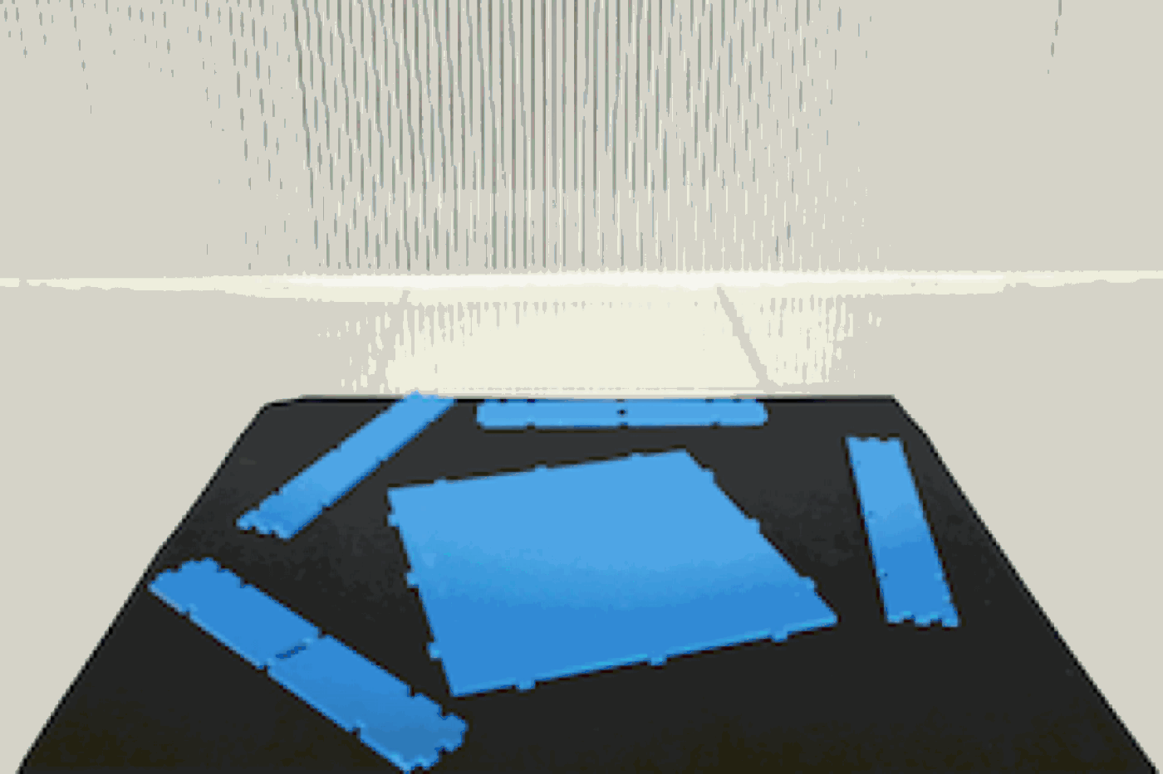
2.Greenhouse Design
2.1 First Design
In this design we got inspired from MIT’s Open Agriculture Initiative: Personal Food Computer. We tried to scale up their design to meet our needs.

Slide 8
2.Greenhouse Design
2.1 First Design
Advantages
(a) Can be assembled and taken apart
(b) The joints strength
Disadvantages
(a) Percentage of the light transition
(b) Electrical and water separation
(c) Water circulation
(d) Not enough space for arm movement

Slide 9
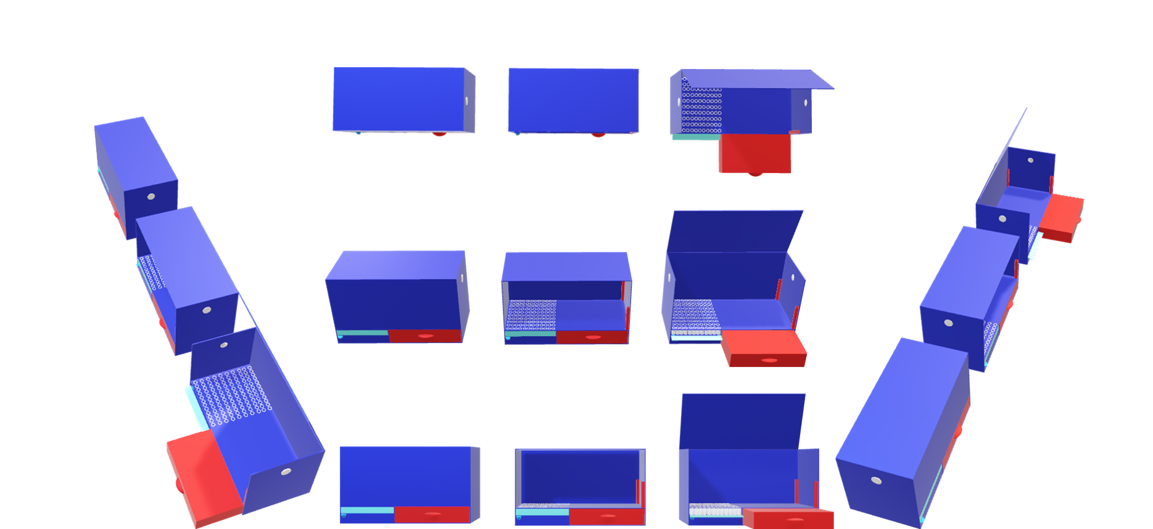
2.Greenhouse Design
2.2 Second Design
In the second design we tried to use our 3D design skills to make a greenhouse with the robotic arm in the center. We decided to have four plants on every corner.
Advantages
(a) Details of water circulation
(b) Details of electrical and water separation
(c) Percentage of the light transition
Disadvantages
(a) No exact measurement of the greenhouse
(b) Weak and cannot handle robotic arm movement

Slide 10
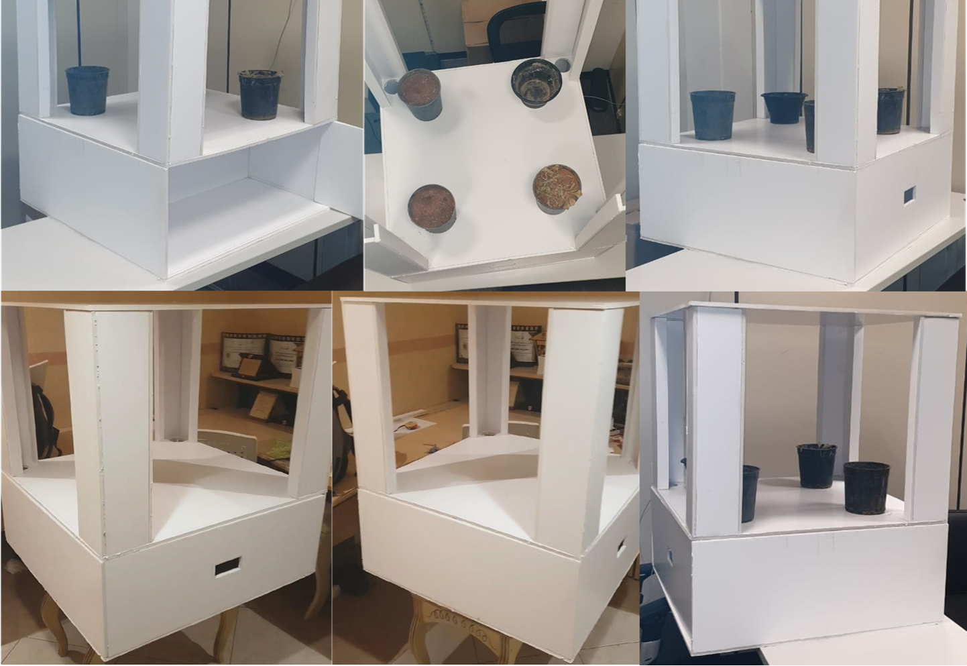
2.Greenhouse Design
2.3 Third design
In this design we have combined what we wanted from the first and the second designs. We came with a much better design that has the water circulation and the separation from the first design. It has the strength, structure, and maintainable parts from the second design.

Slide 11
2.Greenhouse Design
2.3 Third Design
Advantage
(a) Can be assembled and taken apart
(b) The joints strength
(c) Well-structured design
(d) Can handle the arm movement
(e) Water circulation
(f) Electrical separation
Disadvantages
(a) Cost
(b) Manufacture cutting

Slide 12
2.Greenhouse Design
2.2 Overview of the controlled greenhouse system
The system consists of Arduino Megas, robotic arm, and sensors including but not limited to moisture, temperature, and humidity sensors.

Slide 13
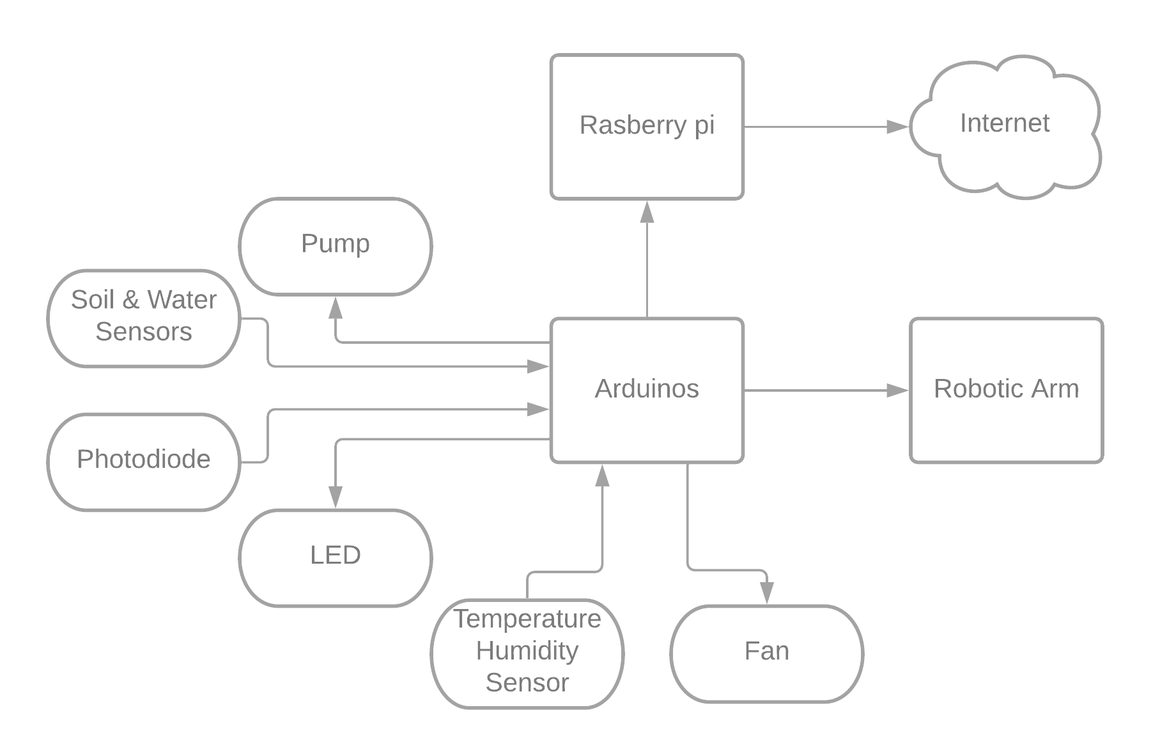
2.Greenhouse Design
2.2 Overview of the controlled greenhouse system
The overall block diagram of the controlled greenhouse system includes multiple Arduino Megas. One is used to control the robotic arm, another one is connected to provide the raspberry pi with all the sensors reading, and the others are controlling the subsystems, as shown in Figure

Slide 14
3.Controlled greenhouse subsystems
3.1 Introduction:
The controlled greenhouse is divided into subsystems and each subsystem is controlled by an Arduino. The subsystems are:
water/pump subsystem.
fan subsystem.
acritical lights system.

Slide 15
3.Controlled greenhouse subsystems
3.2.1 Water/Pump Subsystem
Water is the most important factor for the plant growth and being able to know when the plant requires to be watered is crucial. To automatically water the plants, we use a soil moisture sensor and water level sensor which are attached to the soil that contains the plant.

Slide 16
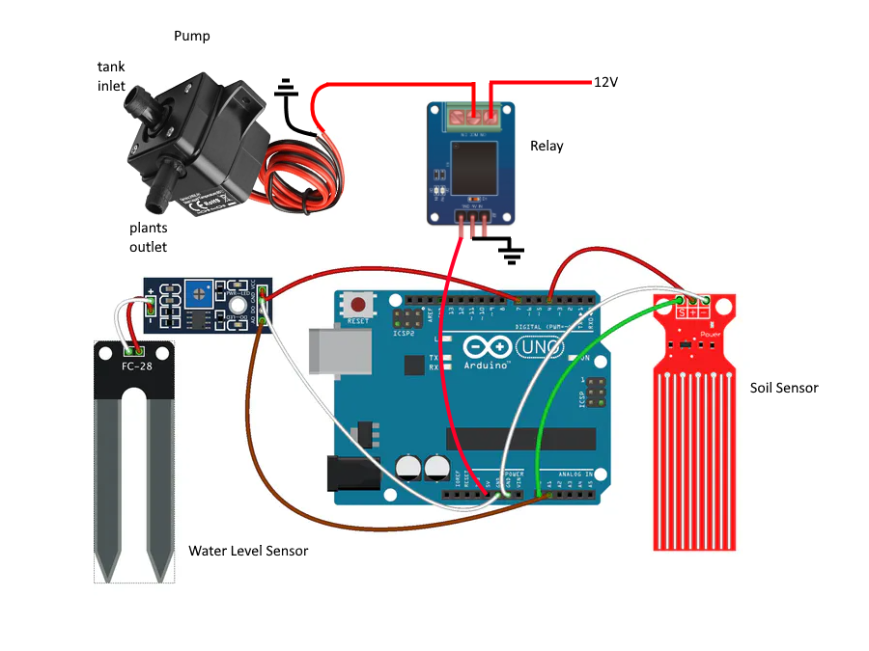
3.Controlled greenhouse subsystems
3.2.1 Water/Pump Subsystem

Slide 17
3.Controlled greenhouse subsystems
3.2.2 Fan Subsystem
Temperature is the second important factor, we can adjust the temperature of the plants since some plants require a dierent environment than others, not all plants have the same temperature requirements for optimal growth.

Slide 18
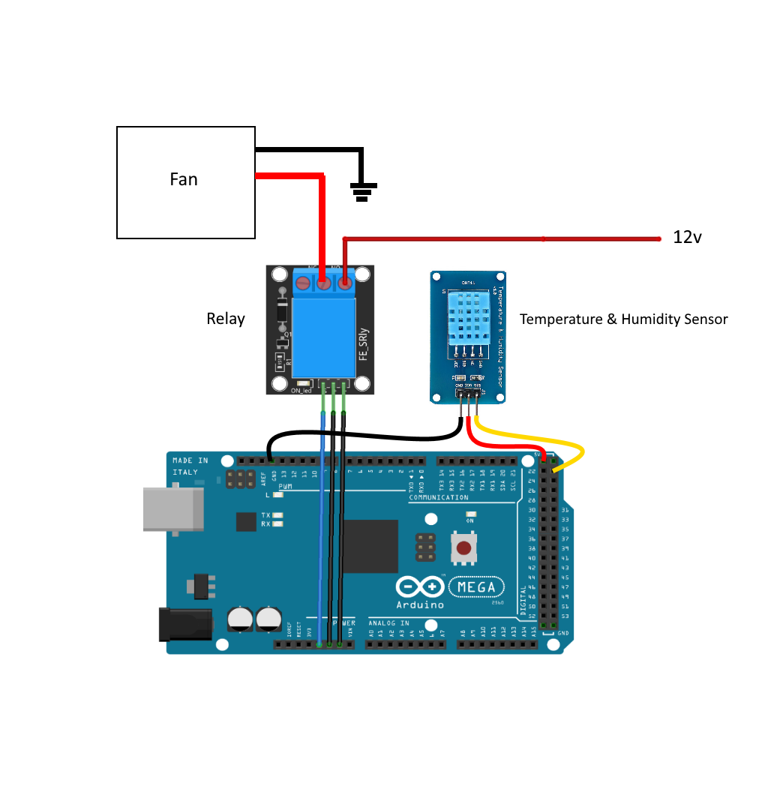
3.Controlled greenhouse subsystems
3.2.2 Fan Subsystem

Slide 19
3.Controlled greenhouse subsystems
3.2.3 Artificial lights Subsystem
Plants must have enough light to survive and produce food and the general case is that the lighter the more food is given by the plant. Since the plants are in a closed environment it cannot get light from the sun thus, we use artificial light.

Slide 20
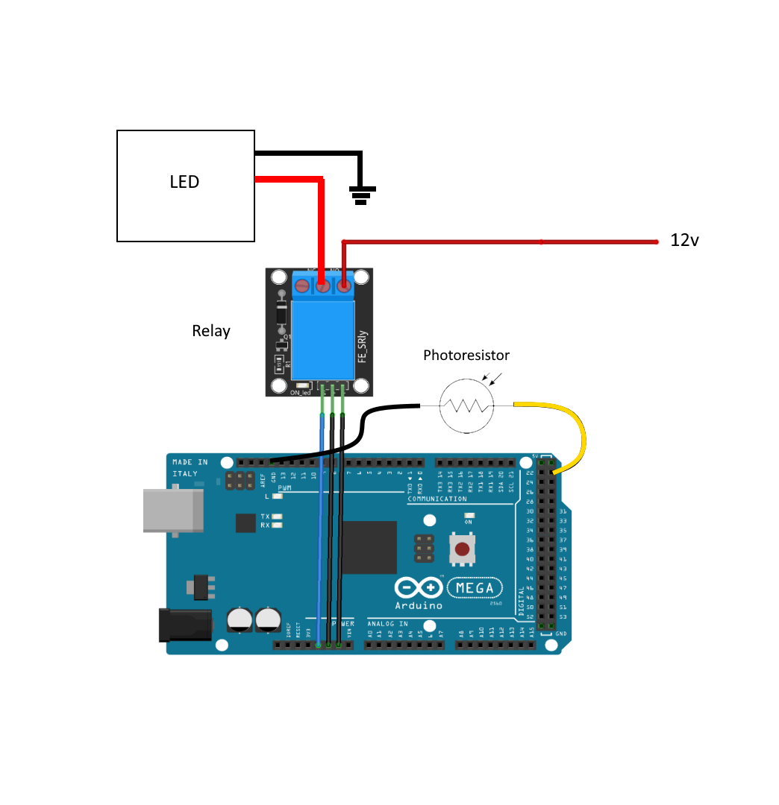
3.Controlled greenhouse subsystems
3.2.3 Artificial lights Subsystem

Slide 21
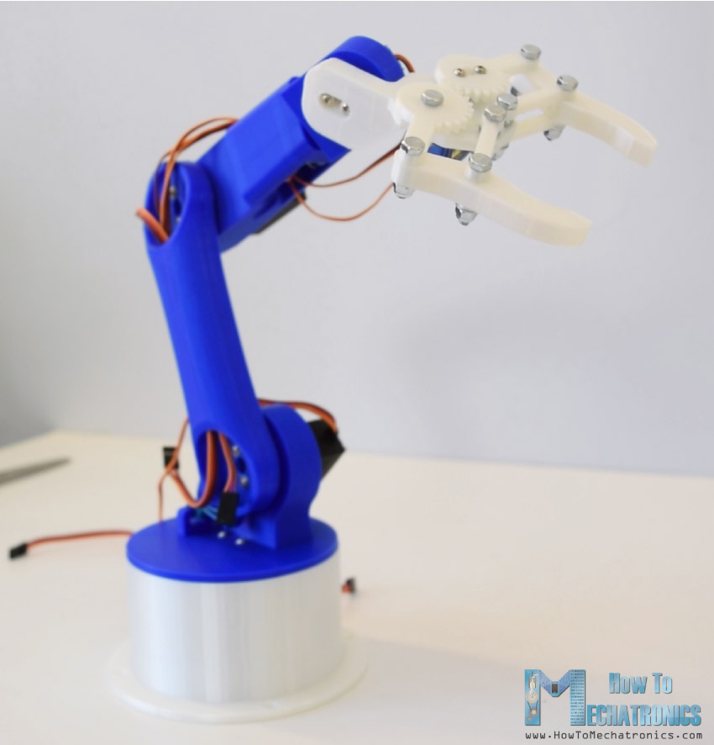
4.Arm control system
4.1 Introduction
Arduino robotic arm from
“How to Mechatronics”
Controlled the arm movement using Arduino

Slide 22

4.Arm control system
4.3 Arduino Robotic Arm Code
Arm control setup algorithm
Arm control loop algorithm
Servo Selector algorithm
Move Servo Fast algorithm
Move Servo Slow algorithm
Read Current Buff algorithm

Slide 23
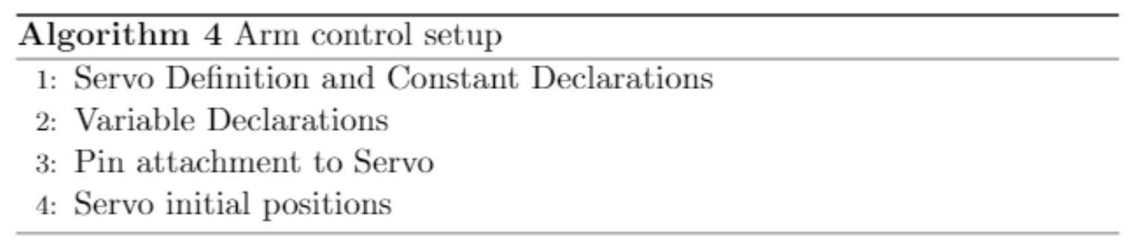
4.Arm control system
4.3 Arduino Robotic Arm Code
In the setup algorithm we have attached the six servos with their pins in the Arduino. After that we have initiated the arm to the straight arm status by giving each servo with it is a specific angle, then we detach the servos and initiate the Bluetooth with 9600 baud rate

Slide 24
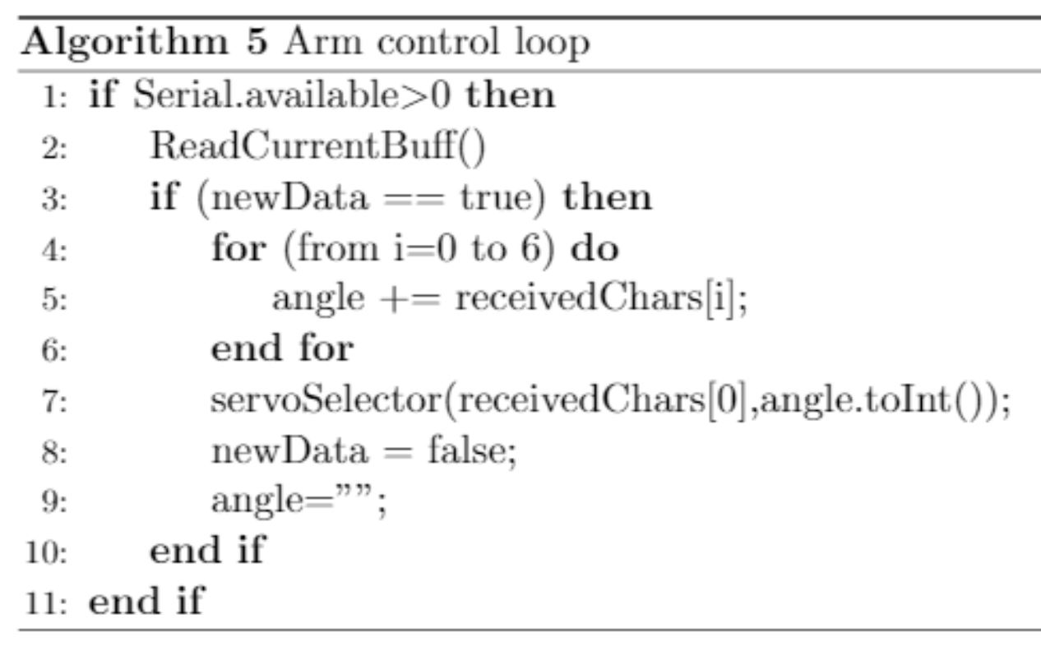
4.Arm control system
4.3 Arduino Robotic Arm Code
The arm control loop algorithm keeps track of the serial port of the Blue-tooth module to read the commands from the buffer using (Read Current-Buff) algorithm. It is reading the command and saves it. Then it sets the new data flag. Once the new data flag is true the (received Chars) string is separated properly and sent to (servo Selector) algorithm witch is going to determine the targeted servo and the desired angle. Then the servo Selector sends the desired angle to the target servo which will apply the command on the servo and the cycle is repeated

Slide 25
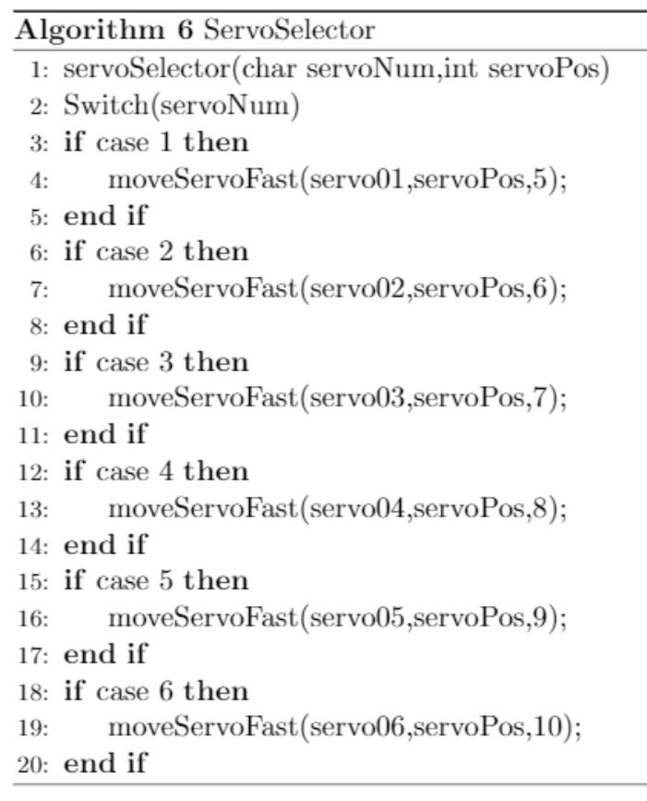
4.Arm control system
4.3 Arduino Robotic Arm Code
Servo Selector algorithm will receive (servo Num) and (servo Pos) then deter-mine the targeted servo based on the (servo Num) and the desired angle based on (servo Pos), then send it to the (move Servo Fast) algorithm

Slide 26
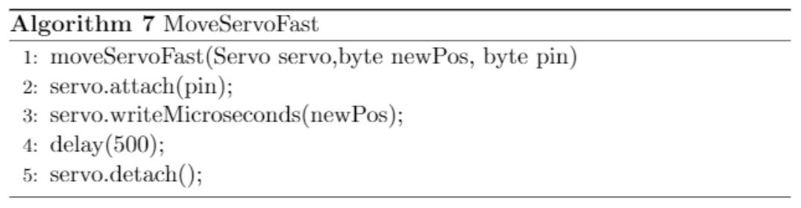
4.Arm control system
4.3 Arduino Robotic Arm Code
Move Servo Fast algorithm will receive the (servo), (new Pos), and (pin). It will use the (pin) to attach the selected servo based on (servo) to the desired pin connected to the Arduino board. It will then apply the command based on (new Pos) using (write Microseconds) algorithm from servo library. Then it will detach the servo after 0.5 second delay

Slide 27
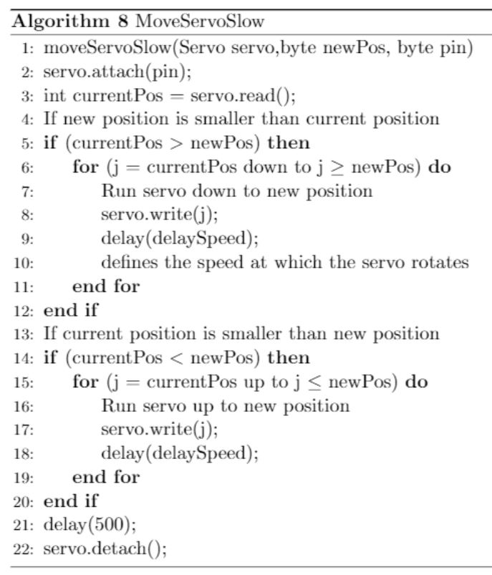
4.Arm control system
4.3 Arduino Robotic Arm Code
Move Servo Slow algorithm will receive the (servo), (new Pos), and (pin). It will use the (pin) to attach the selected servo based on (servo) to the desired pin connected to the Arduino board. Then it will be determined if the new position based on (new Pos) is greater/smaller than the current position. Then it will increment/decrement the position of the servo using (write Microseconds) algorithm from servo library to apply the command. Then it will detach the servo after 0.5 second delay

Slide 28
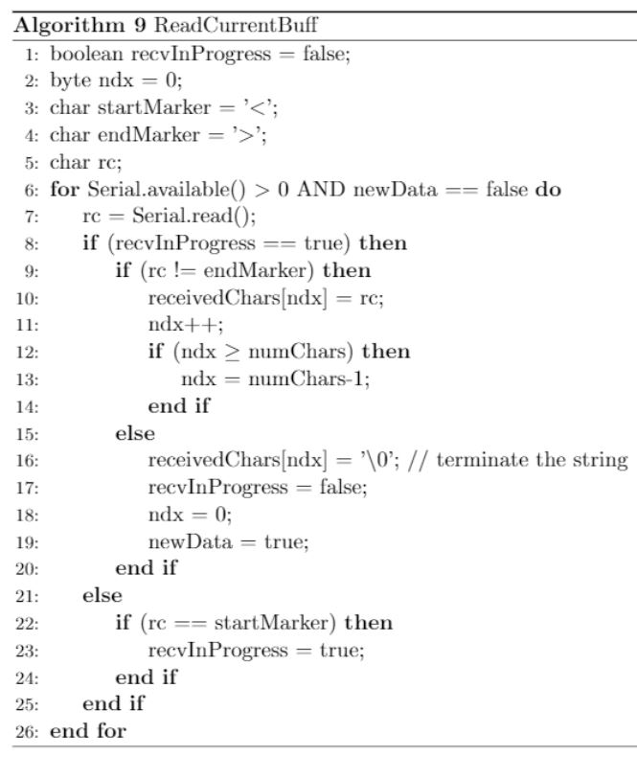
4.Arm control system
4.3 Arduino Robotic Arm Code
Read Current Buff algorithm starts to read from the serial detecting the start marker of the command then it sets the (receive In Progress) flag to true. Once(receive In Progress) is true it is starts to read the command and saves it in(received Chars) string till it reaches the end marker. Then it makes the(receive In Progress) false and terminates the (received Chars) string and clear the index and set the (new data) flag to true

Slide 29
6.Conclusion
3.1 Summary
The project is intended to provide a solution to automatically tend to plants by controlling water, lighting, humidity, and temperature without the user’s input if necessary. We are successful in determining when the plants need watering when to switch the LED and the fan on or o. We developed algorithms to receive commands wirelessly and use it to control the robotic arm movement, and implementing a prototype of the greenhouse using high compression foam boards

Slide 30
6.Conclusion
3.2 Future growth
Subsystem structure – gathering data and transfer to the raspberry.
Neural network to detect the plant and the determine level of growth.
Improve the head of the arm to plant and/or harvest.
Improve the design of box to be acrylic instead of foam, and to be able t hold a camera for the neural network.

Slide 31
Thank you for your time

